Slide 1
UI elements

Slide 2
TOPIC KEY CONCEPTS
LinearLayout Arranges views in a single column or single row
AbsoluteLayout Enables you to specify the exact location of its children
TableLayout Groups views into rows and columns
RelativeLayout Enables you to specify how child views are positioned relative to
each other
FrameLayout A placeholder on screen that you can use to display a single view
ScrollView A special type of FrameLayout in that it enables users to scroll
through a list of views that occupy more space than the physical
display allows

Slide 3
USING BASIC VIEWS
To get started, this section explores some of the basic views that you can use to design the UI
of your Android applications:
➤ TextView
➤ EditText
➤ Button
➤ ImageButton
➤ CheckBox
➤ ToggleButton
➤ RadioButton
➤ RadioGroup
These basic views enable you to display text information, as well as perform some basic selection.

Slide 4
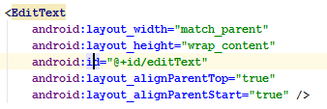
TextView View
The TextView view is used to display text to the user.
If you need to allow users to edit the text displayed, you should use the subclass of TextView, EditText.

Slide 5
Button, ImageButton, EditText, CheckBox, ToggleButton, RadioButton, and RadioGroup Views
Besides the TextView view, which you will likely use the most often, there are some other basic views that you will find yourself frequently using:
➤ Button — Represents a push-button widget
➤ ImageButton — Similar to the Button view, except that it also displays an image
➤ EditText — A subclass of the TextView view that allows users to edit its text content
➤ CheckBox — A special type of button that has two states: checked or unchecked
➤ RadioGroup and RadioButton — The RadioButton has two states: either checked or
unchecked.. A RadioGroup is used to group together one or more RadioButton views,
thereby allowing only one RadioButton to be checked within the RadioGroup.
➤ ToggleButton — Displays checked/unchecked states using a light indicator

Slide 6
The following Try It Out provides details about how these views work.
create an Android project and name it BasicViews1.
Modify the main.xml fi le located in the res/layout folder by adding the following elements shown in bold:

Slide 7
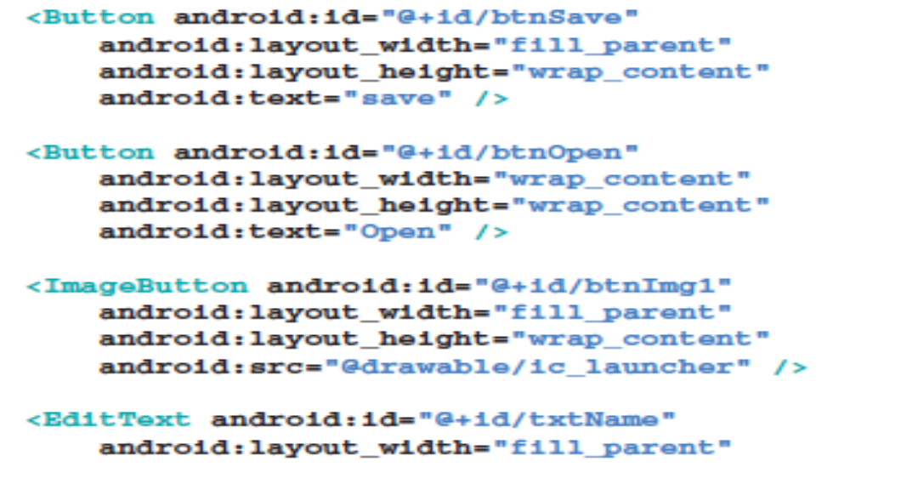

Slide 8
shows the following changes to the view:
➤ The first CheckBox view (Autosave) is checked.
➤ The second CheckBox View (star) is selected.
➤ The second RadioButton (Option 2) is selected.
➤ The ToggleButton is turned on.

Slide 9
The attribute is set to fill_parent so that its width occupies the entire width of the screen.
The attribute is set to wrap_content so that its width will be the
width of its content — specifi cally, the text that it is
The ImageButton displays a button with an image.
The image is set through the src attribute. In this case, you simply used the image for the application icon.

Slide 10
The EditText view displays a rectangular region where the user can enter some text.
You set the layout_height to wrap_content so that if the user enters a long string of text, its height will automatically be adjusted to fi t the content.
The CheckBox displays a checkbox that users can tap to check or uncheck.
If you do not like the default look of the CheckBox, you can apply a style attribute to it to display it as another image, such as a star.

Slide 11
The format for the value of the style attribute is as follows:
?[package:][type:]name
The RadioGroup encloses two RadioButtons. This is important because radio buttons are usually used to present multiple options to the user for selection.
When a RadioButton in a RadioGroup is selected,all other RadioButtons are automatically unselected.

Slide 12
The RadioButtons are listed vertically, one on top of another.
If you want to list them horizontally, you need to change the orientation attribute to horizontal.
You would also need to ensure that the layout_width attribute of the RadioButtons are set to wrap_content.
The ToogleButton displays a rectangular button that users can toggle on and off by clicking.

Slide 13
One thing that has been consistent throughout this example is that each view has the id attribute set to a particular value.
The id attribute is an identifier for a view so that it may later be retrieved using the View.findViewById() or Activity.findViewById() methods.

Slide 15
To handle the events fired by each view, you first have to programmatically locate the view that you created during the onCreate() event.
You do so using the findViewById() method (belonging to the
Activity base class), supplying it with the ID of the view:

